Slide 1


Diwali sales Analysis
exploring Consumer Behavior During Festival Season
Prepared By:
Aditya Kumar Pandey
MTech (AI & DS), 240201001
Dept. of CSE, IIIT Bhagalpur
Submitted To:
Dr. Avantika
Assistant Professor
Dept. of CSE, IIIT Bhagalpur
01

Slide 2

Case Study
Introduction
Diwali Sales Analysis – Exploring Consumer Behavior During Festival Season
Objective: To analyze consumer purchase patterns during Diwali using a retail sales dataset.
Goal: Derive actionable business insights through data visualization and statistical exploration.
02

Slide 3

dataset
information
Dataset Type: Structured CSV file
Source: Kaggle
Total Records: ~11,000+ rows (varies based on cleaning)
Purpose: Captures transactional and customer demographic data during Diwali season
Features:
User_ID: Unique identifier for each customer
Cust_name: Customer name
Product_ID: Unique product identifier
Gender: Male or Female
Age Group: Age grouped into ranges (e.g., 18-25, 26-35)
Age: Exact age in years
Marital_Status: Indicates if customer is married
State: State where purchase was made
Zone: Geographical zone (North, South, etc.)
Occupation: Profession of customer
Product_Category: Category under which product falls
Orders: Number of units ordered
Amount: Total purchase amount
unnamed: NA
03

Slide 4


data
preprocessing
Dataset Loaded from CSV
Initial Exploration
Converted Data Types
Checked Missing Values
Post-Cleaning Summary
04

Slide 5
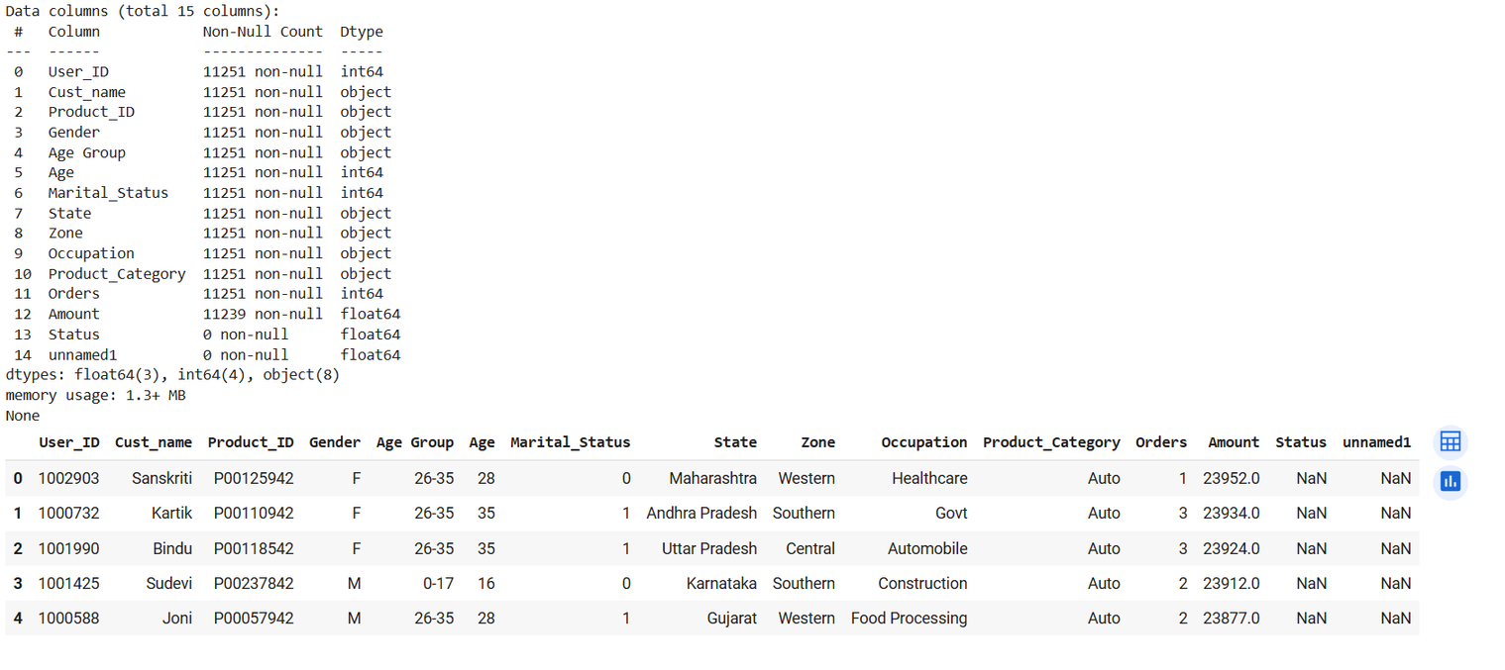
data
preprocessing
Pre-Cleaning Data Summary
05

Slide 6
Null Values | count
User_ID | 0
Cust_ID | 0
Product_ID | 0
Gender | 0
Age Group | 0
Marital Status | 0
State | 0
Zone | 0
Occupation | 0
Product_Category | 0
Orders | 0
Amount | 12
data Preprocessing
Initial Data overview
We have 11,251 rows and 15 columns.
df['Amount'] = df['Amount'].astype('int') : This converts the Amount column from float to integer
Amount: 12 nulls
Status: all nulls
unnamed1: all nulls
These two columns (Status, unnamed1) are completely empty, and Amount has 12 missing entries.
df.drop(['Status', 'unnamed1'], axis=1, inplace=True)
This line removes the two completely empty columns — they don’t add any value to the analysis.
06

Slide 7
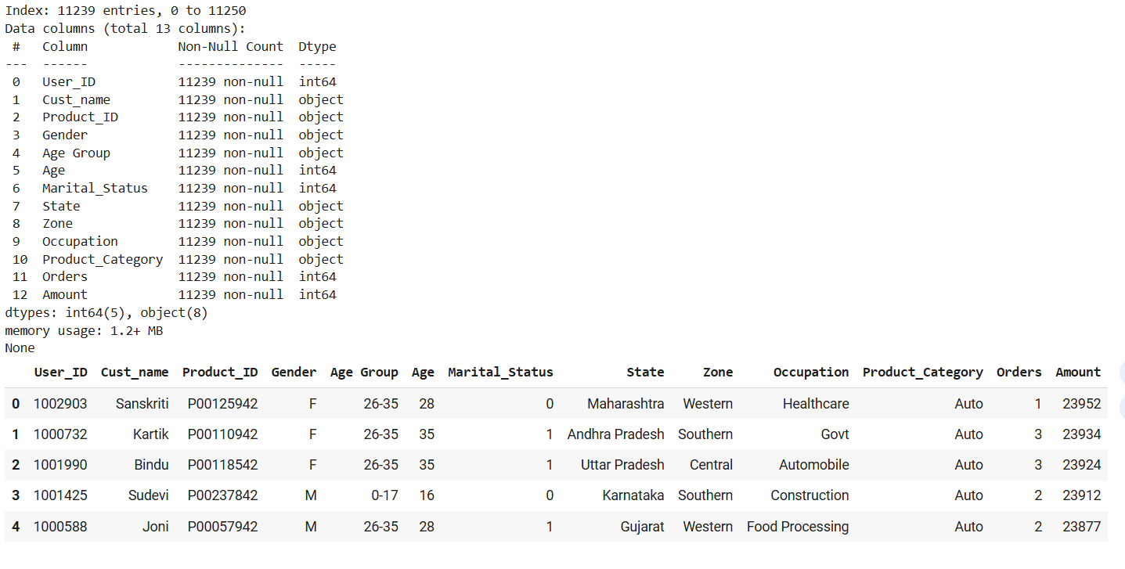
data
preprocessing
Post Cleaning Data Summary
07

Slide 8
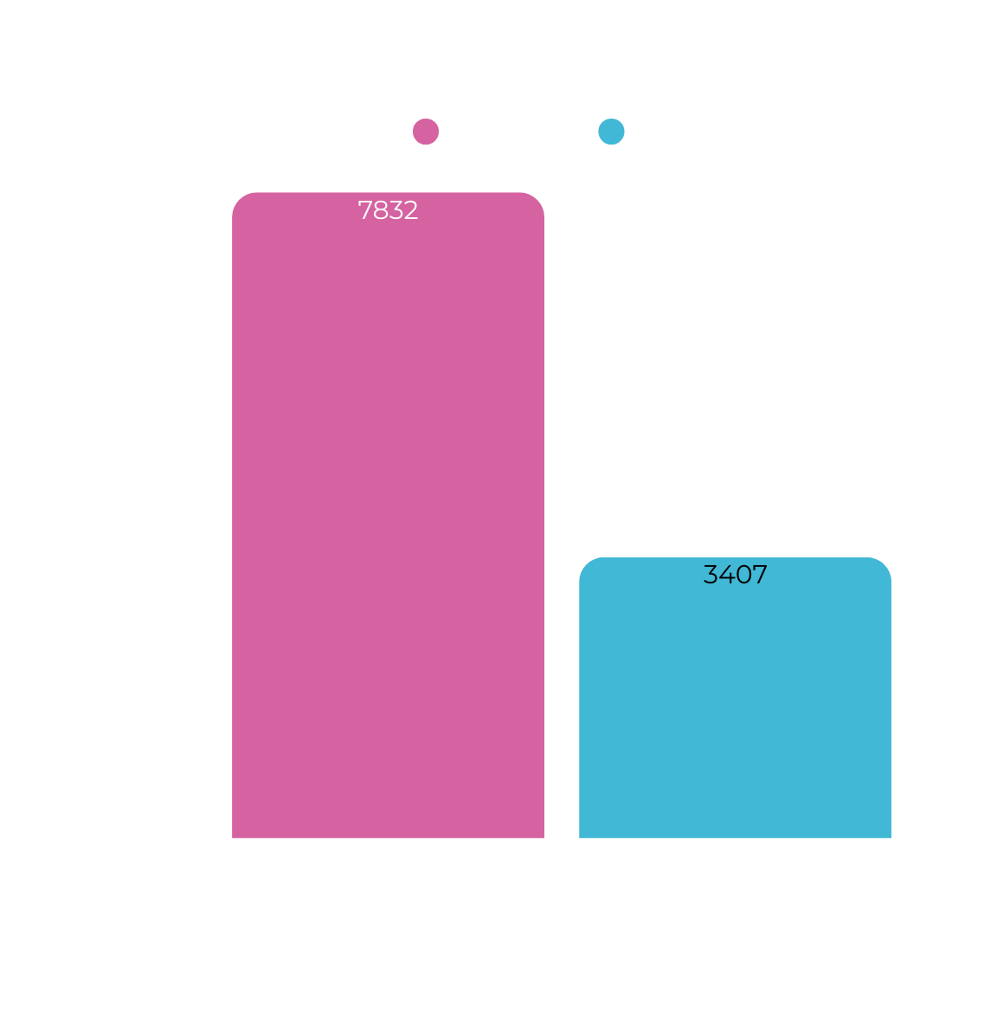
EXPLORATORY DATA ANALYSIS
Gender distribution
Counted male vs female customers using a bar chart.
Majority of shoppers were Female.
08

Slide 9

le7
EXPLORATORY DATA ANALYSIS
Gender vs Total Amount Spent
Sales data is grouped by gender to analyze spending patterns.
Total amount spent by females (F) is significantly higher than males (M).
Suggests that female customers were more active shoppers during Diwali..
1e7 means the values are in millions.
09

Slide 10
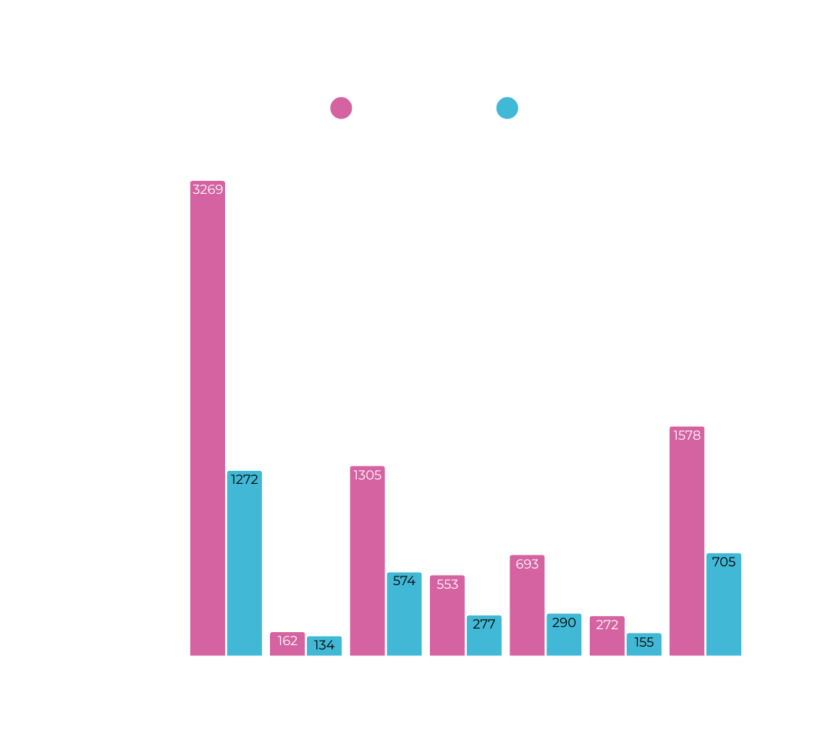
EXPLORATORY DATA ANALYSIS
Age Group Distribution by Gender
This chart shows:
Which age groups are most active.
Gender distribution in each age group.
Most customers might be in the 26-35 age group.
Both males and females are well represented, but females dominate in some groups.
26-35
0-17
18-35
51-55
46-50
55+
36-45
Age Group
10

Slide 11
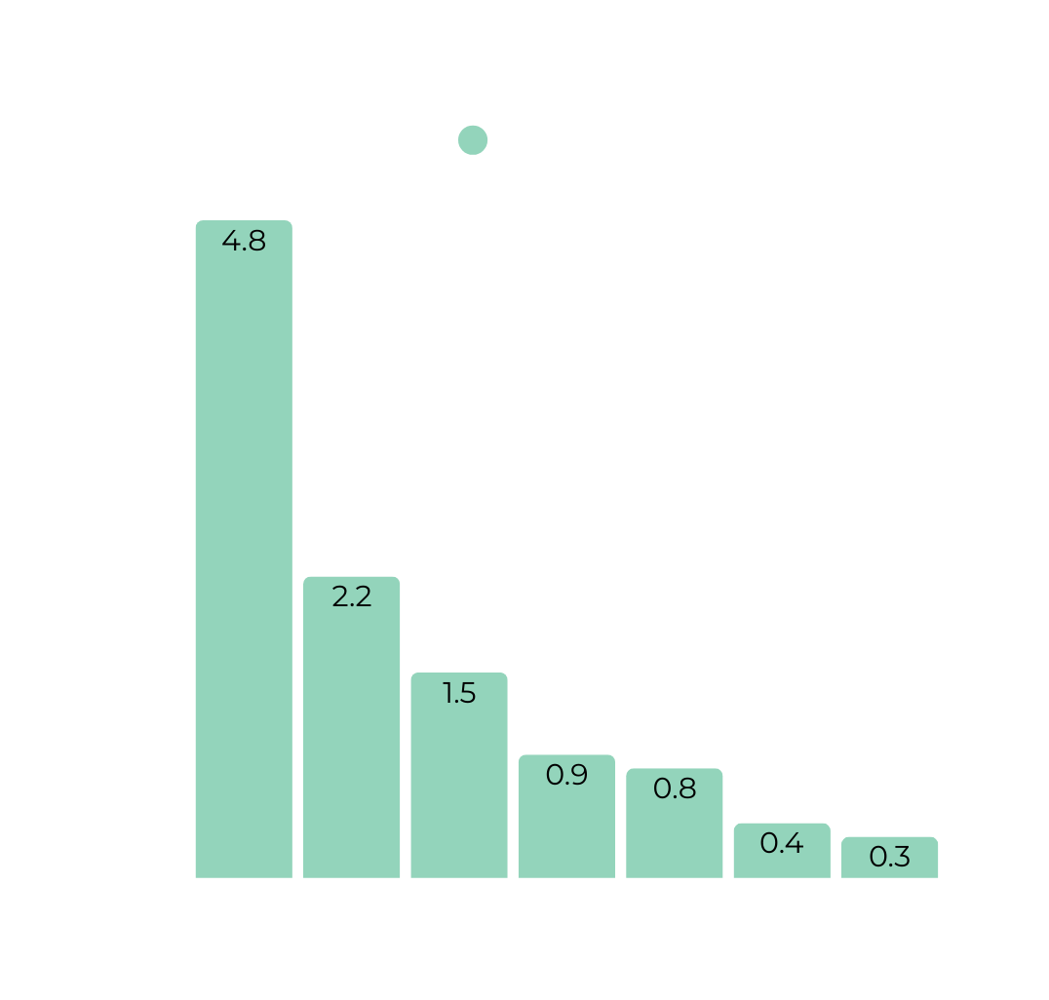
le7
EXPLORATORY DATA ANALYSIS
Total Amount Spent by Age Group
Shows spending power of different age groups.
Likely, the 26-35 or 36-45 groups spend the most — prime working age.
Helps target marketing for high-spending age demographics.
26-35
36-45
18-25
46-50
51-55
55+
0-17
11
Age Group

Slide 12
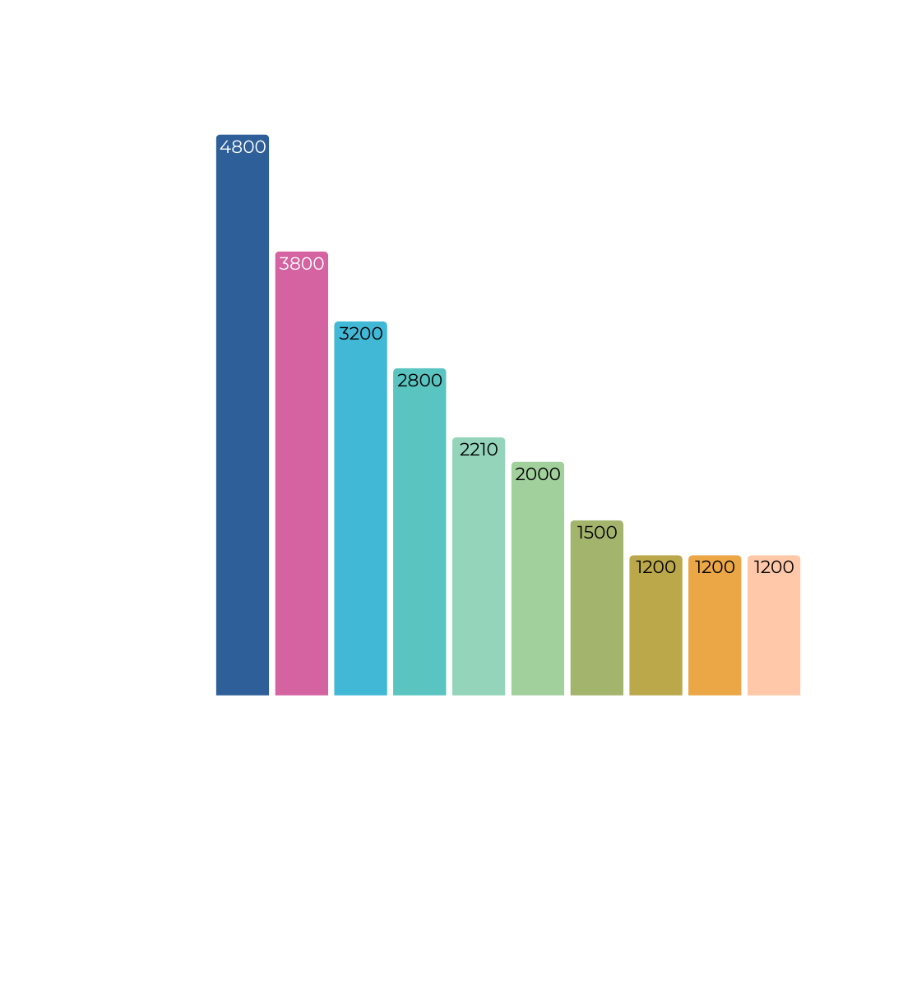
EXPLORATORY DATA ANALYSIS
Top 10 States by Number of Orders
Visualizes the states with the highest number of purchases.
Likely leaders: Uttar Pradesh, Maharashtra, Karnataka, etc.
Useful for identifying geographic hot spots in terms of customer activity.
12

Slide 13
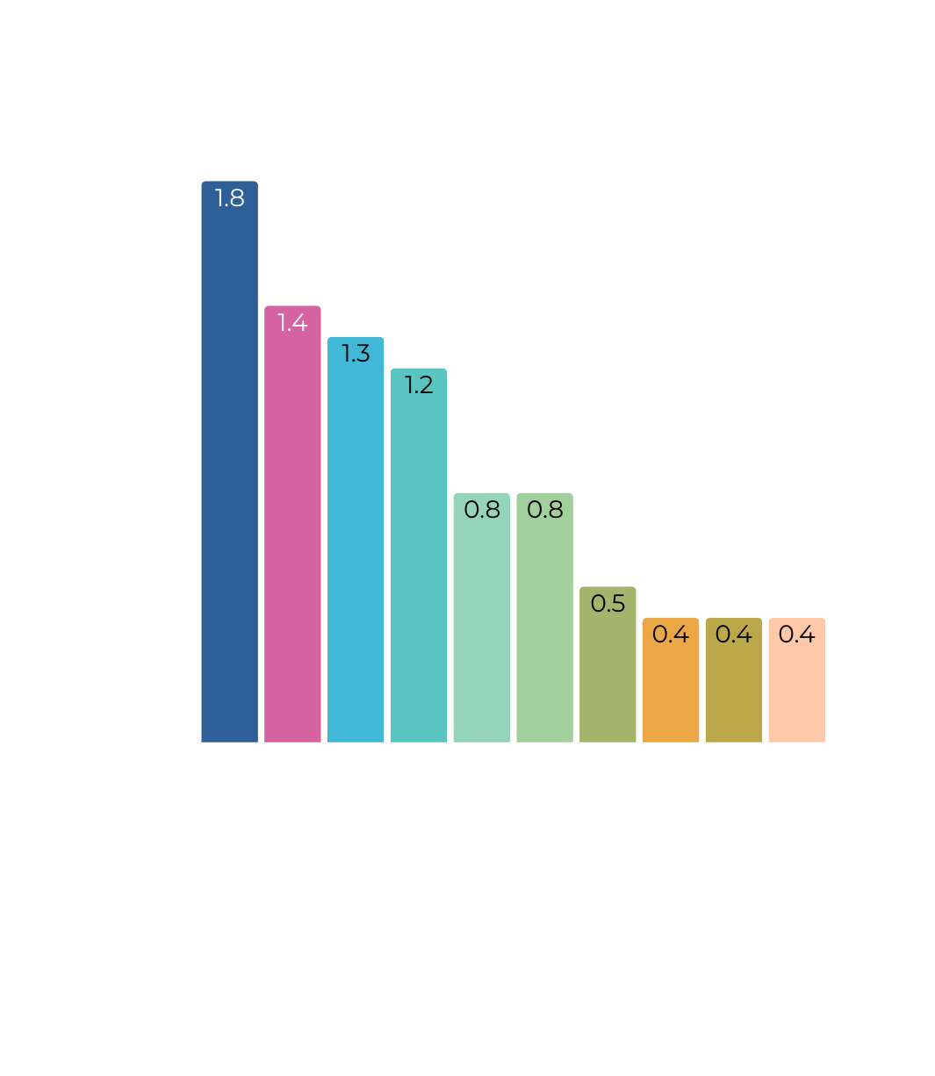
le7
EXPLORATORY DATA ANALYSIS
Top 10 States by Sales Amount
Reveals top contributing states in revenue.
Some states might have fewer orders but higher value per order.
Helps in prioritizing marketing, logistics, and sales efforts geographically.
13

Slide 14
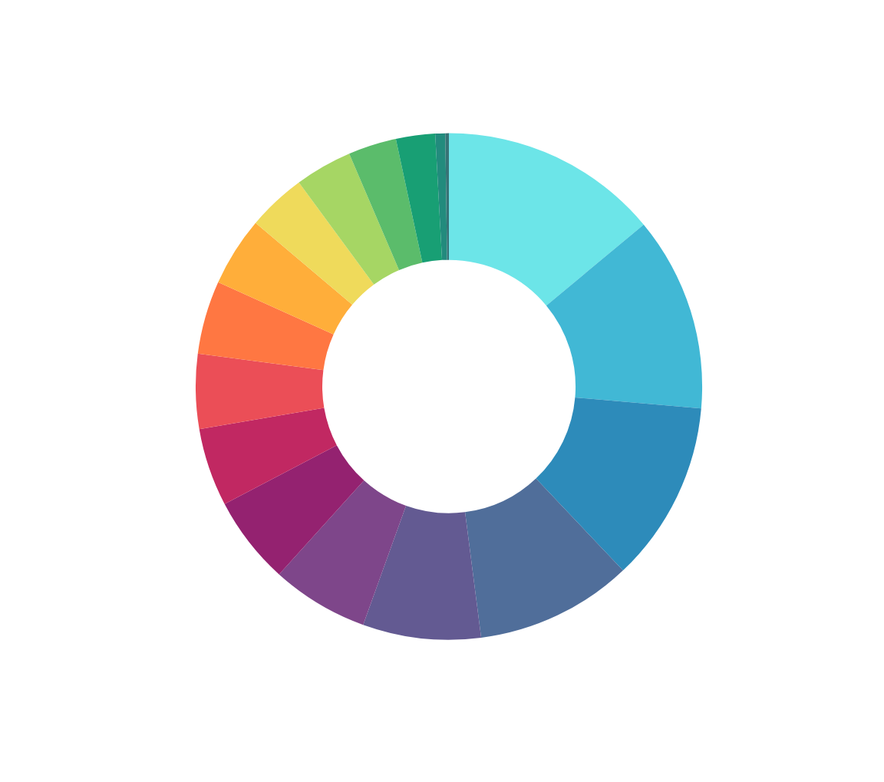
EXPLORATORY DATA ANALYSIS
Occupation-wise Distribution of Diwali Shoppers
Top Spenders:
IT Sector (1583) and Healthcare (1408) lead due to high income and tech adoption.
Aviation (1310) and Banking (1137) also show strong festive buying power.
Moderate Participation:
Govt (854), Hospitality (703), and Media (637) balance tradition with modern spending.
Low Engagement:
Agriculture (283), Textile (349), and Construction (414) may face income or access constraints.
Growth Potential:
Automobile, Retail, Food Processing, and Law show scope for targeted promotions.
Marketing Tip:
Focus premium campaigns on top sectors, and offer EMI deals or festive combos for low-engagement groups.
14

Slide 15
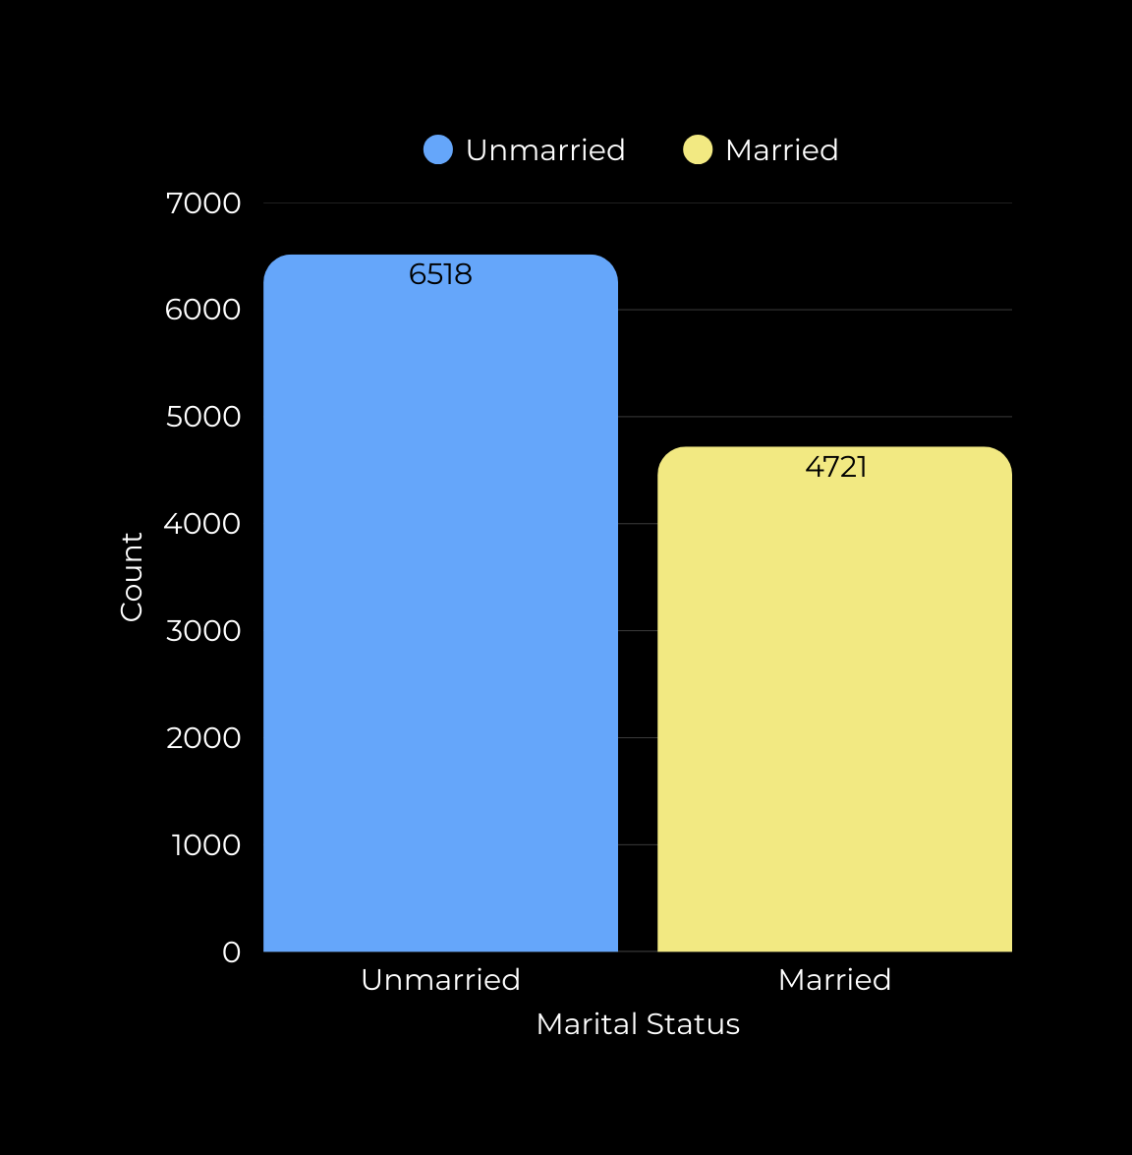
EXPLORATORY DATA ANALYSIS
marital status count
This chart shows the number of customers based on marital status.
The dataset has more unmarried customers (6518) compared to married ones (4721).
15

Slide 16
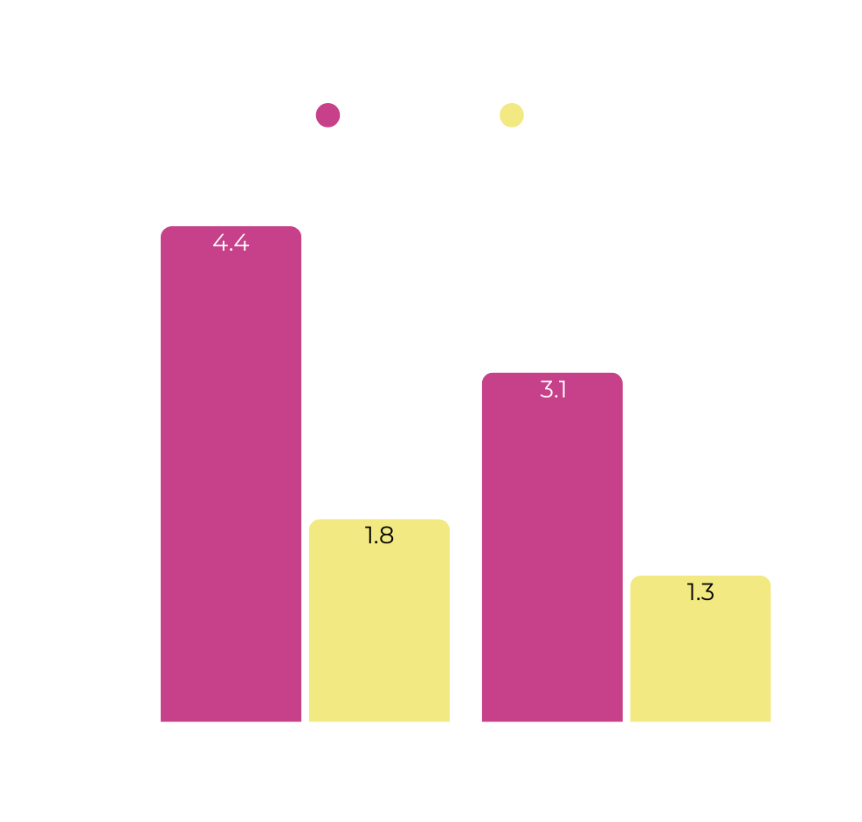
le7
EXPLORATORY DATA ANALYSIS
Marital Status vs Amount
Unmarried Females (Marital Status = Ummariied, Gender=F) spent the most, with the bar reaching over ₹4 crores.
Unmarried Males also spent significantly, but less than females in the same group.
Among the married group (Marital Status = Married), females again spent more than males, but both spent less compared to the unmarried group.
Unmarried
Married
Marital Status
16

Slide 17
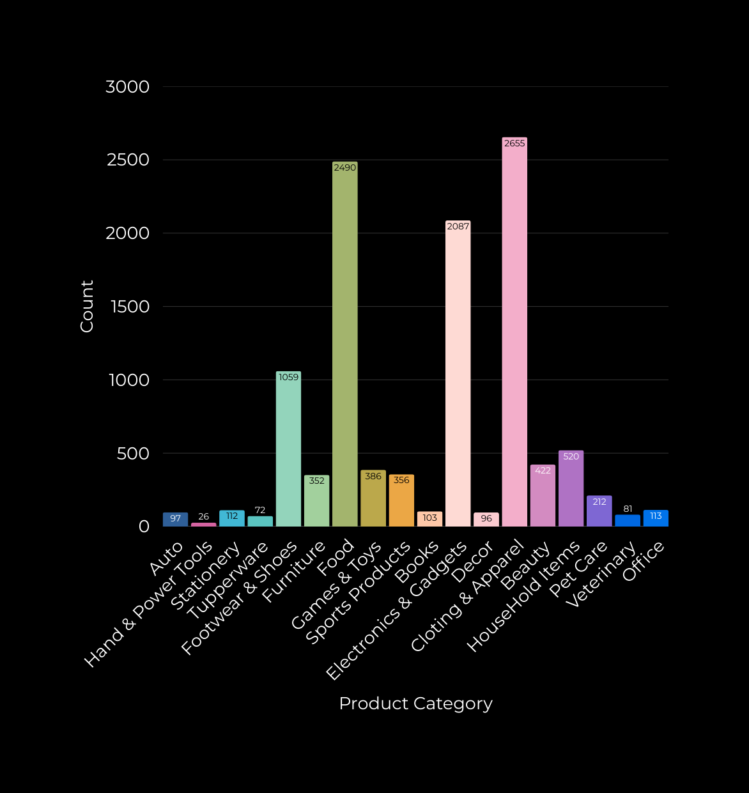
EXPLORATORY DATA ANALYSIS
Product Category Distribution
Clothing & Apparel is the most popular category with 2,655 sales, followed by:
Food – 2,490 sales
Electronics & Gadgets – 2,087 sales
Moderate performance seen in:
Footwear & Shoes – 1,059 sales
Household items – 520 sales
Beauty – 422 sales
Games & Toys – 386 sales
Sports Products – 356 sales
Niche categories with lower sales include:
Furniture – 352
Pet Care – 212
Office Supplies – 113
Stationery – 112
Least engaged categories:
Books – 103
Auto – 97
Decor – 96
Veterinary – 81
Tupperware – 72
Hand & Power Tools – 26
17

Slide 18
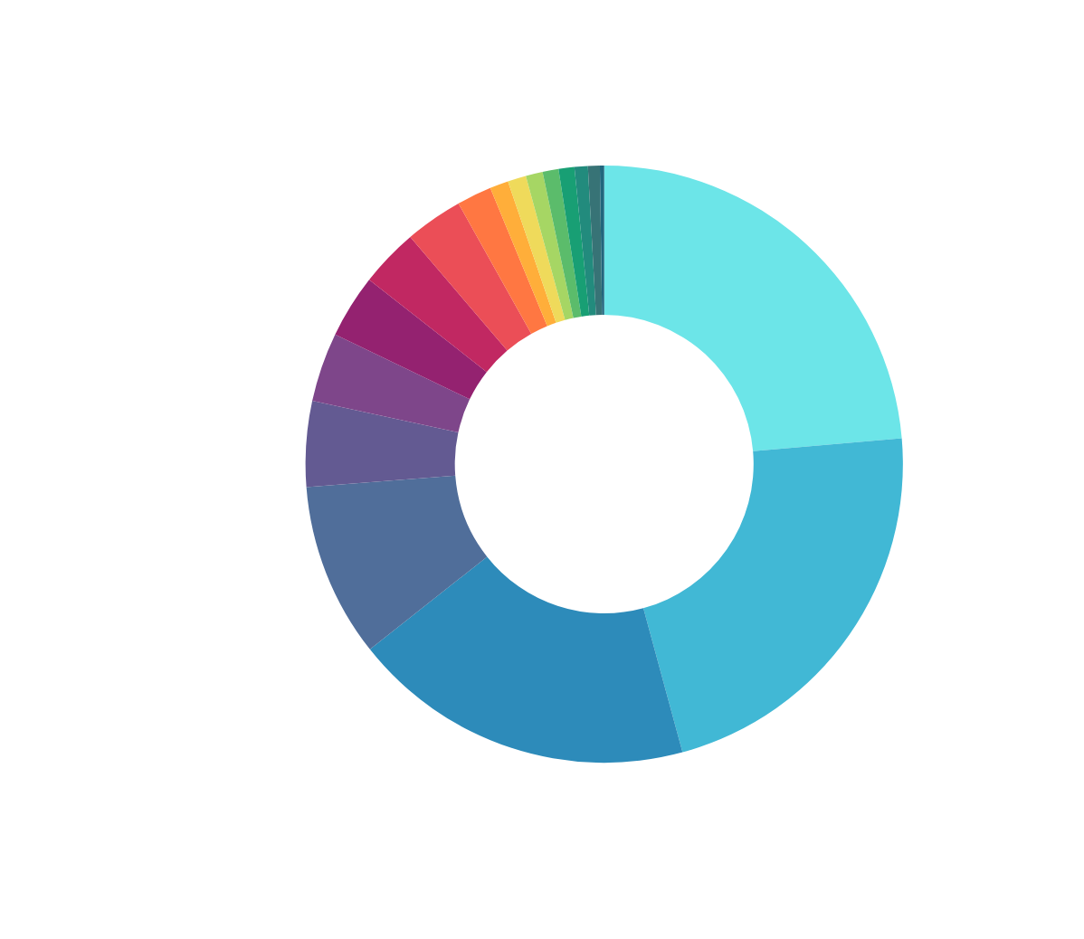
EXPLORATORY DATA ANALYSIS
Product Category Distribution - Donut Chart
18

Slide 19

Real-World
Applications
Customer Segmentation
Identify high-value customers (e.g., IT, Healthcare) to tailor premium offers.
Targeted Marketing Campaigns
Use spending patterns by occupation and region to personalize festive or seasonal promotions.
Product Performance Insights
Understand which product categories (e.g., Auto, Electronics) drive revenue to optimize inventory.
Sales Forecasting
Predict demand based on past purchase behavior for efficient stock management.
18

Slide 20
business
recommendations
Launch campaigns specifically for Govt Employees, Hospitality, or Students with relevant perks.
Prioritize IT, Healthcare, Banking, and Aviation with loyalty programs or premium bundles.
Younger customers (18-35) may prefer tech deals; older ones may go for healthcare or utility products.
Design budget-friendly bundles, festive sales, or EMI options for Construction, Agriculture, etc.
20

Slide 21
thank
you!
DATA ANALYSIS IS KEY TO BUSINESS GROWTH AND SUCCESS!
ADITYA KUMAR PANDEY
MTECH (AI & DS), IIIT BHAGALPUR
LINKEDIN
19

